Slide 1


Slide 2
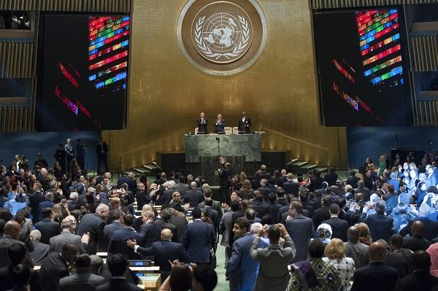
Szczyt Zrównoważonego Rozwoju 2015
Notes:
In September 2015, more than 150 world leaders attended the UN Sustainable Development Summit held at UN Headquarters in New York to formally adopt an ambitious new sustainable development agenda.
Reflected in this Agenda are seventeen Sustainable Development Goals - our shared vision of humanity and a social contract between the world's leaders and the people.

Slide 3
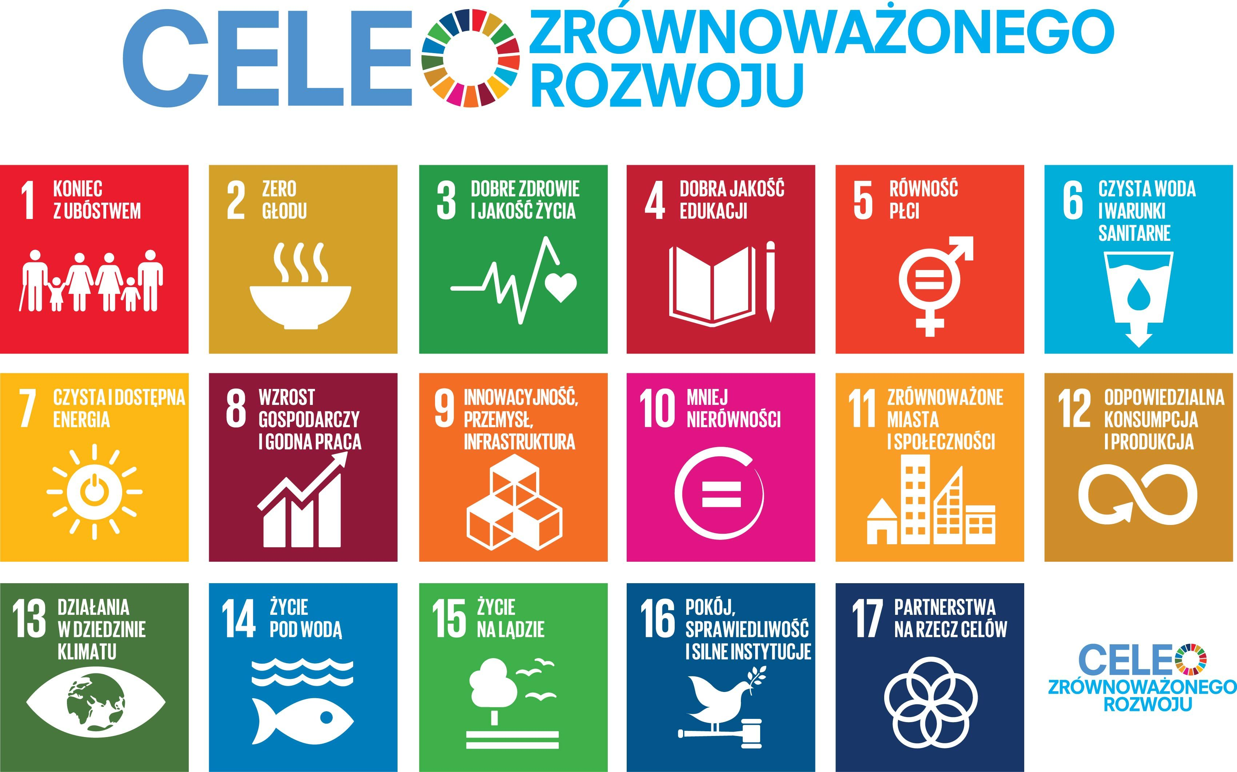
Notes:
On 1 January, 2016, the 17 Sustainable Development Goals (SDGs) of the 2030 Agenda for Sustainable Development—adopted by world leaders in September 2015 at an historic UN Summit — officially came into force. Over the next fifteen years, with these new Goals that universally apply to all, countries will mobilize efforts to end all forms of poverty, fight inequalities and tackle climate change, while ensuring that no one is left behind.
The SDGs build on the success of the Millennium Development Goals (MDGs) and aim to go further to end all forms of poverty. The new Goals are unique in that they call for action by all countries, poor, rich and middle-income to promote prosperity while protecting the planet. They recognize that ending poverty must go hand-in-hand with strategies that build economic growth and addresses a range of social needs including education, health, social protection, and job opportunities, while tackling climate change and environmental protection.

Slide 4

Cel 1: Wyeliminować ubóstwo we wszystkich jego formach na całym świecie
Prawie miliard ludzi żyje
za mniej niż 1,25 USD dziennie
Głód
Prawo do własności
Brak przychodów
Wykluczenie społeczne
Niedożywienie
Systemy ochrony socjalnej
Notes:
Extreme poverty rates have been cut by more than half since 1990. While this is a remarkable achievement, one in five people in developing regions still live on less than $1.25 a day, and there are millions more who make little more than this daily amount, plus many people risk slipping back into poverty.
Poverty is more than the lack of income and resources to ensure a sustainable livelihood. Its manifestations include hunger and malnutrition, limited access to education and other basic services, social discrimination and exclusion as well as the lack of participation in decision-making. Economic growth must be inclusive to provide sustainable jobs and promote equality.

Slide 5

Cel 2: Wyeliminować głód, osiągnąć bezpieczeństwo żywnościowe i lepsze odżywianie oraz promować zrównoważone rolnictwo
800 milionów głodujących
Praca
Susze
Rolnictwo
Migracje
Bezpieczeństwo żywnościowe
Odżywianie
Notes:
If done right, agriculture, forestry and fisheries can provide nutritious food for all and generate decent incomes, while supporting people-centred rural development and protecting the environment.
Right now, our soils, freshwater, oceans, forests and biodiversity are being rapidly degraded. Climate change is putting even more pressure on the resources we depend on, increasing risks associated with disasters such as droughts and floods. Many rural women and men can no longer make ends meet on their land, forcing them to migrate to cities in search of opportunities.
A profound change of the global food and agriculture system is needed if we are to nourish today’s 795 million hungry and the additional 2 billion people expected by 2050.
The food and agriculture sector offers key solutions for development, and is central for hunger and poverty eradication

Slide 6

Cel 3: Zapewnić wszystkim ludziom w każdym wieku zdrowe życie oraz promować dobrobyt
Ponad 6 milionów dzieci umiera przed ukończeniem piątego roku życia
Średnia długość życia
HIV/AIDS
Planowanie rodziny
Śmiertelność dzieci i matek
Choroby
Ochrona zdrowia
Notes:
Ensuring healthy lives and promoting the well-being for all at all ages is essential to sustainable development. Significant strides have been made in increasing life expectancy and reducing some of the common killers associated with child and maternal mortality. Major progress has been made on increasing access to clean water and sanitation, reducing malaria, tuberculosis, polio and the spread of HIV/AIDS. However, many more efforts are needed to fully eradicate a wide range of diseases and address many different persistent and emerging health issues.

Slide 7

Cel 4: Zapewnić wszystkim edukację wysokiej jakości oraz promować uczenie się przez całe życie
103 mln młodych ludzi nie potrafi pisać, czytać i liczyć
Równy dostęp do edukacji na wszystkich poziomach
Zwiększyć liczbę nauczycieli
Zwiększyć liczbę placówek edukacyjnych
Polepszenie życia
Notes:
Obtaining a quality education is the foundation to improving people’s lives and sustainable development. Major progress has been made towards increasing access to education at all levels and increasing enrolment rates in schools particularly for women and girls. Basic literacy skills have improved tremendously, yet bolder efforts are needed to make even greater strides for achieving universal education goals. For example, the world has achieved equality in primary education between girls and boys, but few countries have achieved that target at all levels of education.

Slide 8
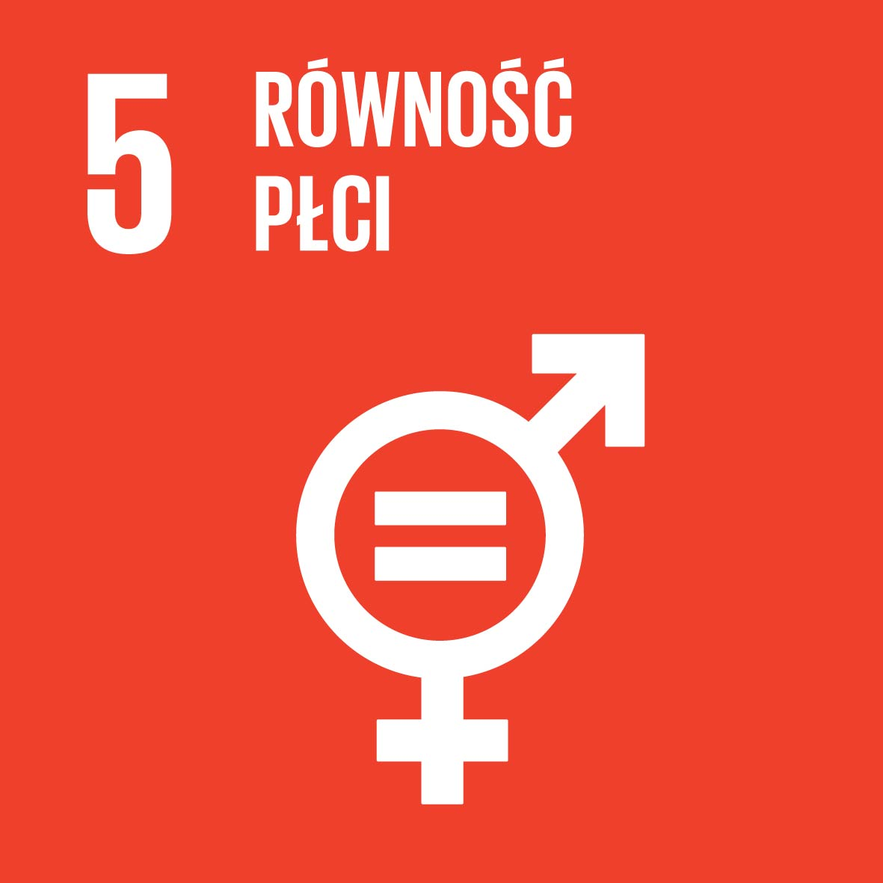
Cel 5: Osiągnąć równość płci oraz wzmocnić pozycję kobiet i dziewcząt
Prawa własności
Równy dostęp do edukacji, opieki zdrowotnej i godziwej pracy
Udział w procesie decyzyjnym
Nieodpłatna praca
Pokój i dobrobyt
Prawa kobiet
Przemoc i dyskryminacja
Notes:
While the world has achieved progress towards gender equality and women’s empowerment under the Millennium Development Goals (including equal access to primary education between girls and boys), women and girls continue to suffer discrimination and violence in every part of the world.
Gender equality is not only a fundamental human right, but a necessary foundation for a peaceful, prosperous and sustainable world.
Providing women and girls with equal access to education, health care, decent work, and representation in political and economic decision-making processes will fuel sustainable economies and benefit societies and humanity at large.

Slide 9

Cel 6: Zapewnić wszystkim ludziom dostęp do wody i warunków sanitarnych poprzez zrównoważoną gospodarkę zasobami wodnymi
40% światowej populacji ma ograniczony dostęp do wody
Choroby
Bezpieczeństwo żywnościowe
Edukacja
Głód i niedożywienie
Notes:
Clean, accessible water for all is an essential part of the world we want to live in. There is sufficient fresh water on the planet to achieve this. But due to bad economics or poor infrastructure, every year millions of people, most of them children, die from diseases associated with inadequate water supply, sanitation and hygiene.
Water scarcity, poor water quality and inadequate sanitation negatively impact food security, livelihood choices and educational opportunities for poor families across the world. Drought afflicts some of the world’s poorest countries, worsening hunger and malnutrition.
By 2050, at least one in four people is likely to live in a country affected by chronic or recurring shortages of fresh water

Slide 10
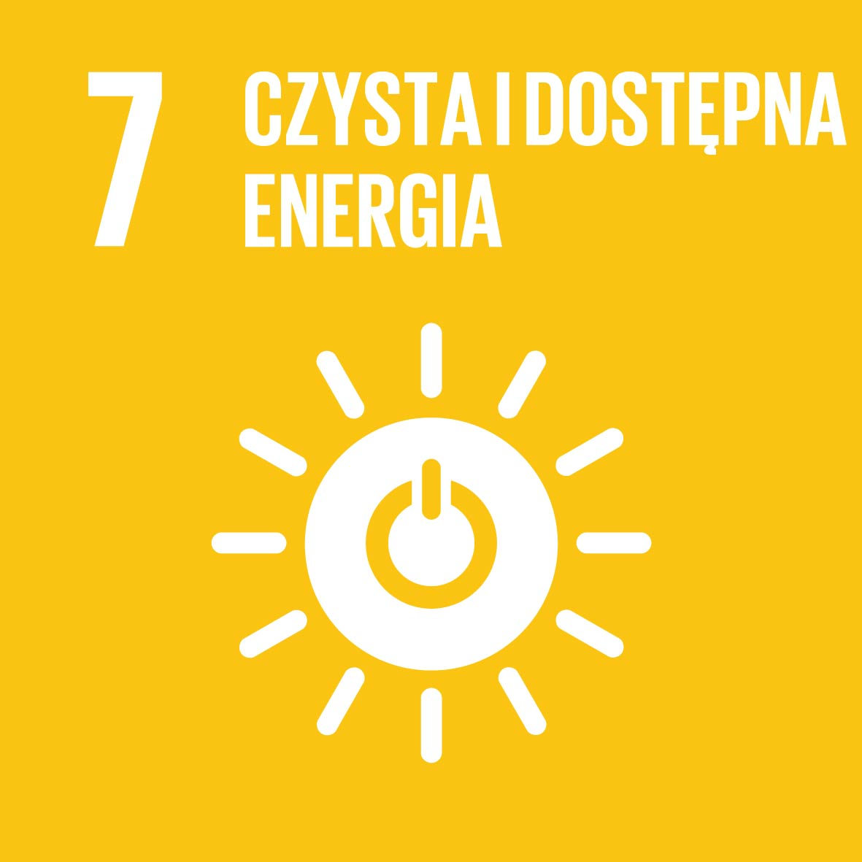
Cel 7: Zapewnić wszystkim dostęp do stabilnej, zrównoważonej i nowoczesnej energii po przystępnej cenie
Szansa na lepszą przyszłość
Produkcja żywności
Zmiany klimatyczne
Miejsca pracy
Dostęp do technologii
Bezpieczeństwo
Notes:
Energy is central to nearly every major challenge and opportunity the world faces today. Be it for jobs, security, climate change, food production or increasing incomes, access to energy for all is essential.
Sustainable energy is opportunity – it transforms lives, economies and the planet.
UN Secretary-General Ban Ki-moon is leading a Sustainable Energy for All initiative to ensure universal access to modern energy services, improve efficiency and increase use of renewable sources.

Slide 11

Cel 8: Promować silny, zrównoważony i inkluzywny wzrost gospodarczy, pełne i produktywne zatrudnienie oraz godną pracę dla wszystkich ludzi
Do 2030 r. potrzebnych będzie 470 mln miejsc pracy dla młodych
Jakość życia
Polityki społeczne, inwestycje
Praca nie chroni przed ubóstwem
Produktywne zatrudnienie dla młodych
Godziwe miejsca pracy
Notes:
Roughly half the world’s population still lives on the equivalent of about US$2 a day. And in too many places, having a job doesn’t guarantee the ability to escape from poverty. This slow and uneven progress requires us to rethink and retool our economic and social policies aimed at eradicating poverty.
A continued lack of decent work opportunities, insufficient investments and under-consumption lead to an erosion of the basic social contract underlying democratic societies: that all must share in progress. . The creation of quality jobs will remain a major challenge for almost all economies well beyond 2015.
Sustainable economic growth will require societies to create the conditions that allow people to have quality jobs that stimulate the economy while not harming the environment. Job opportunities and decent working conditions are also required for the whole working age population.

Slide 12
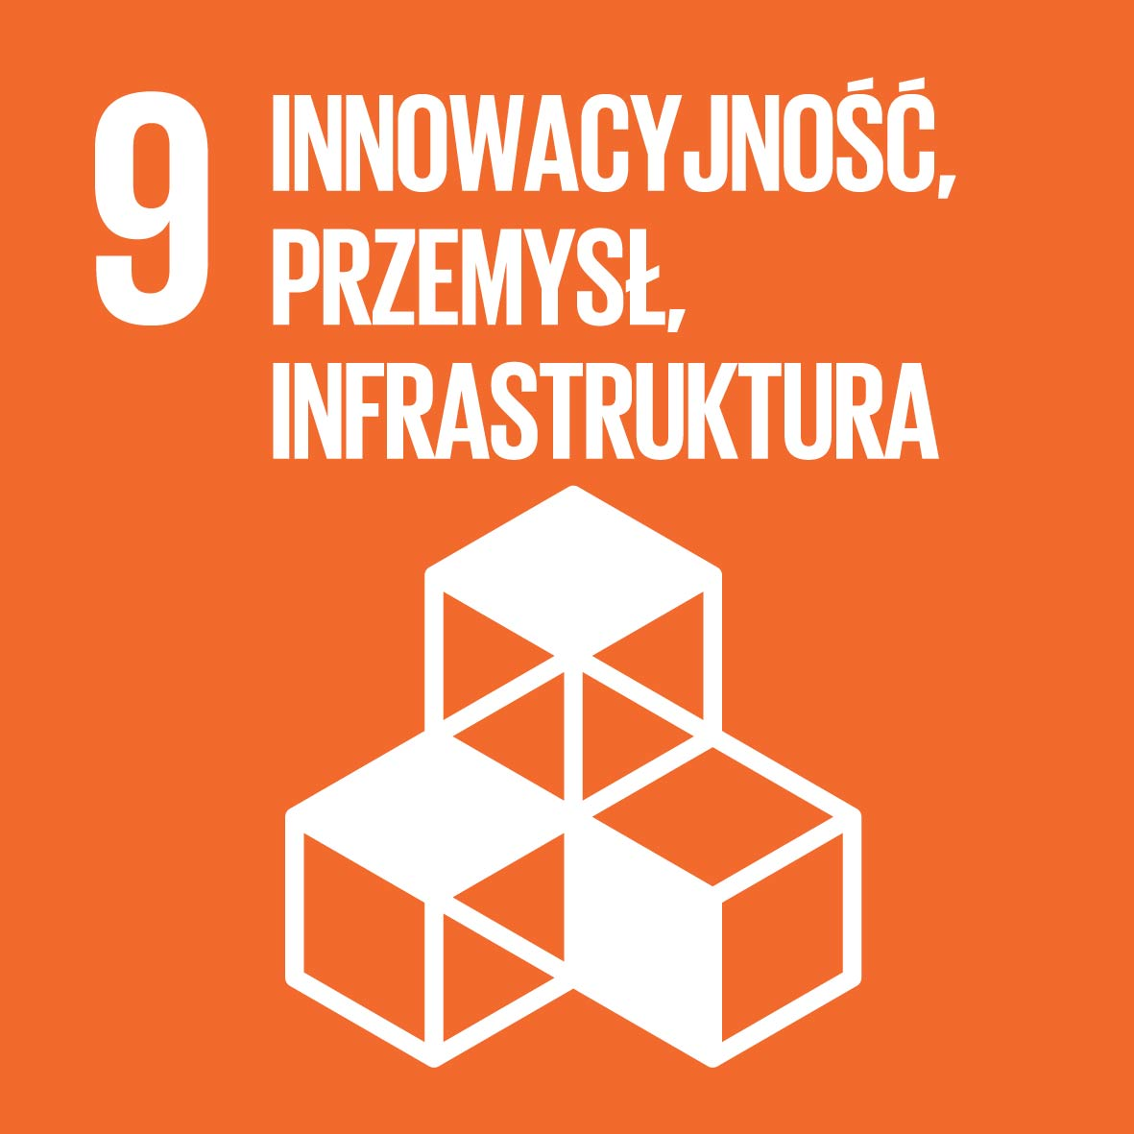
Cel 9: Budować stabilną infrastrukturę, promować zrównoważone uprzemysłowienie oraz wspierać innowacyjność
Dostęp do pracy i usług finansowych
Dobre zdrowie, edukacja
Inwestycje w transport, energię, nowe technologie
Rozwój małych i średnich przedsiębiorstw
Notes:
Investments in infrastructure – transport, irrigation, energy and information and communication technology – are crucial to achieving sustainable development and empowering communities in many countries. It has long been recognized that growth in productivity and incomes, and improvements in health and education outcomes require investment in infrastructure.
Inclusive and sustainable industrial development is the primary source of income generation, allows for rapid and sustained increases in living standards for all people, and provides the technological solutions to environmentally sound industrialization.
Technological progress is the foundation of efforts to achieve environmental objectives, such as increased resource and energy-efficiency. Without technology and innovation, industrialization will not happen, and without industrialization, development will not happen.

Slide 13

Cel 10: Zmniejszyć nierówności w krajach i między krajami
1% ludzi posiada 40% światowego majątku. Biedniejsza połowa światowej populacji posiada łącznie 1% światowego majątku.
Równe szanse dla każdego
Nierównomiernie rozłożony dochód
Inkluzywny postęp gospodarczy
Pomoc rozwojowa
Polityki i system prawny, ochrona socjalna
Notes:
The international community has made significant strides towards lifting people out of poverty. The most vulnerable nations – the least developed countries, the landlocked developing countries and the small island developing states – continue to make inroads into poverty reduction. However, inequality still persists and large disparities remain in access to health and education services and other assets.
Additionally, while income inequality between countries may have been reduced, inequality within countries has risen. There is growing consensus that economic growth is not sufﬁcient to reduce poverty if it is not inclusive and if it does not involve the three dimensions of sustainable development – economic, social and environmental.
To reduce inequality, policies should be universal in principle paying attention to the needs of disadvantaged and marginalized populations.

Slide 14

Cel 11: Uczynić miasta i osiedla ludzkie bezpiecznymi, stabilnymi, zrównoważonymi oraz sprzyjającymi włączeniu społecznemu
Grupy wrażliwe (niepełnosprawni, dzieci)
Bezpieczeństwo
Połowa populacji świata mieszka w miastach
Zanieczyszczenie
Prawie miliard ludzi mieszka w slumsach
Transport, budownictwo, infrastruktura
Notes:
Cities are hubs for ideas, commerce, culture, science, productivity, social development and much more. At their best, cities have enabled people to advance socially and economically.
However, many challenges exist to maintaining cities in a way that continues to create jobs and prosperity while not straining land and resources. Common urban challenges include congestion, lack of funds to provide basic services, a shortage of adequate housing and declining infrastructure.
The challenges cities face can be overcome in ways that allow them to continue to thrive and grow, while improving resource use and reducing pollution and poverty. The future we want includes cities of opportunities for all, with access to basic services, energy, housing, transportation and more.

Slide 15

Cel 12: Zapewnić wzorce zrównoważonej konsumpcji i produkcji
Wyrzucamy 1/3 całej światowej żywności
5 miliardów ludzi ma nadwagę albo jest otyła
Jeśli nie zmienimy obecnego stylu życia, to
w 2050 roku będziemy potrzebować zasobów trzech planet takich jak Ziemia
Oszczędzanie energii i zasobów naturalnych
Recykling
Podniesienie świadomości
Notes:
Sustainable consumption and production is about promoting resource and energy efficiency, sustainable infrastructure, and providing access to basic services, green and decent jobs and a better quality of life for all. Its implementation helps to achieve overall development plans, reduce future economic, environmental and social costs, strengthen economic competitiveness and reduce poverty.
Sustainable consumption and production aims at “doing more and better with less,” increasing net welfare gains from economic activities by reducing resource use, degradation and pollution along the whole lifecycle, while increasing quality of life. It involves different stakeholders, including business, consumers, policy makers, researchers, scientists, retailers, media, and development cooperation agencies, among others.
It also requires a systemic approach and cooperation among actors operating in the supply chain, from producer to final consumer. It involves engaging consumers through awareness-raising and education on sustainable consumption and lifestyles, providing consumers with adequate information through standards and labels and engaging in sustainable public procurement, among others.

Slide 16

Cel 13: Podjąć pilne działania w celu przeciwdziałania zmianom klimatu i ich skutkom
Wysokie koszty zmian klimatycznych
Zmiana wzorców pogodowych
Wyższe temperatury = niższe zbiory żywności
Ocieplenie - dwukrotna wielkość Hiszpanii, tyle pokrywy lodowej topnieje w każdej dekadzie.
Zagrożenie dla życia ludzkiego
Zmiany klimatyczne nie znają granic państwowych
Notes:
Climate change is now affecting every country on every continent. It is disrupting national economies and affecting lives, costing people, communities and countries dearly today and even more tomorrow.
People are experiencing the significant impacts of climate change, which include changing weather patterns, rising sea level, and more extreme weather events. The greenhouse gas emissions from human activities are driving climate change and continue to rise. They are now at their highest levels in history. Without action, the world’s average surface temperature is projected to rise over the 21st century and is likely to surpass 3 degrees Celsius this century—with some areas of the world expected to warm even more. The poorest and most vulnerable people are being affected the most.
Affordable, scalable solutions are now available to enable countries to leapfrog to cleaner, more resilient economies. The pace of change is quickening as more people are turning to renewable energy and a range of other measures that will reduce emissions and increase adaptation efforts.
But climate change is a global challenge that does not respect national borders. Emissions anywhere affect people everywhere. It is an issue that requires solutions that need to be coordinated at the international level and it requires international cooperation to help developing countries move toward a low-carbon economy.
To address climate change, countries adopted a global agreement in Paris December 2015.

Slide 17

Cel 14: Chronić oceany, morza i zasoby morskie oraz wykorzystywać je w sposób zrównoważony
Zanieczyszczenie mórz
Napędzają światowe ekosystemy
Oceany pochłaniają jedną trzecią CO2
Rybołówstwo i zarządzanie zasobami morskimi
Oceany stanowią 99% przestrzeni do życia na Ziemi
Kwestia państw wyspiarskich
Notes:
The world’s oceans – their temperature, chemistry, currents and life – drive global systems that make the Earth habitable for humankind.
Our rainwater, drinking water, weather, climate, coastlines, much of our food, and even the oxygen in the air we breathe, are all ultimately provided and regulated by the sea. Throughout history, oceans and seas have been vital conduits for trade and transportation.
Careful management of this essential global resource is a key feature of a sustainable future.

Slide 18
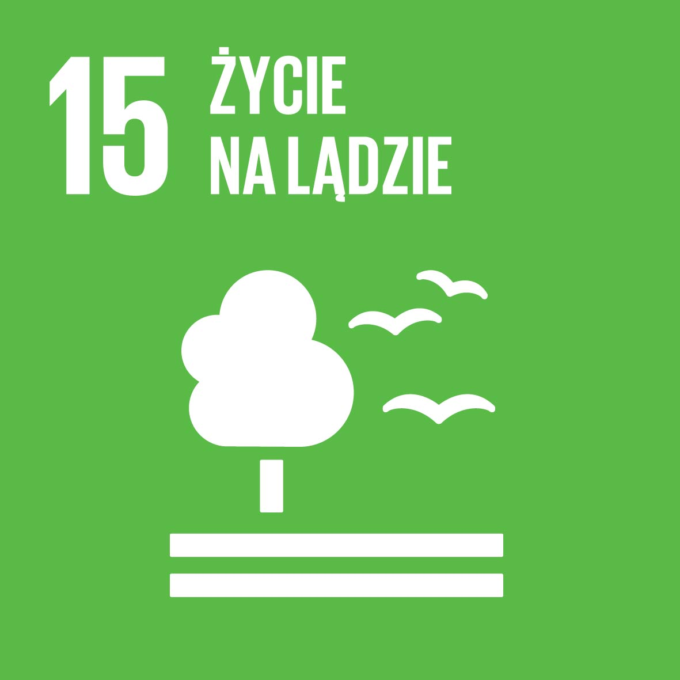
Cel 15: Chronić, przywrócić oraz promować zrównoważone użytkowanie ekosystemów lądowych, zrównoważone gospodarowanie lasami, zwalczać pustynnienie, powstrzymywać i odwracać proces degradacji gleby oraz powstrzymać utratę różnorodności biologicznej
Bioróżnorodność
Ochrona i odtwarzanie ekosystemów
Lasy pokrywają 30% powierzchni Ziemi
Wylesianie, susze, pustynnienie
Ochrona ginących gatunków
Zrównoważone zarządzanie lasami
Notes:
Forests cover 30 per cent of the Earth’s surface and in addition to providing food security and shelter, forests are key to combating climate change, protecting biodiversity and the homes of the indigenous population. Thirteen million hectares of forests are being lost every year while the persistent degradation of drylands has led to the desertification of 3.6 billion hectares.
Deforestation and desertification – caused by human activities and climate change – pose major challenges to sustainable development and have affected the lives and livelihoods of millions of people in the fight against poverty. Efforts are being made to manage forests and combat desertification.

Slide 19

Cel 16: Promować pokojowe i inkluzywne społeczeństwa, zapewnić wszystkim ludziom dostęp do wymiaru sprawiedliwości oraz budować na wszystkich szczeblach skuteczne i odpowiedzialne instytucje, sprzyjające włączeniu społecznemu
Proces podejmowania decyzji
Rządy prawa
Podstawowe wolności, legislacja
Korupcja, przestępczość, terroryzm
Handel ludźmi, przemoc
Odpowiedzialne i przejrzyste instytucje
Notes:
Goal 16 of the Sustainable Development Goals is dedicated to the promotion of peaceful and inclusive societies for sustainable development, the provision of access to justice for all, and building effective, accountable institutions at all levels.

Slide 20

Cel 17: Wzmocnić środki wdrażania i ożywić globalne partnerstwo na rzecz zrównoważonego rozwoju
Rozwój i transfer technologii
Oficjalna pomoc rozwojowa dla krajów rozwijających się
Budowa potencjału krajów rozwijających się
Partnerstwa publiczne i publiczno-prywatne z udziałem społeczeństwa obywatelskiego
Sprawiedliwy system handlowy
Notes:
A successful sustainable development agenda requires partnerships between governments, the private sector and civil society. These inclusive partnerships built upon principles and values, a shared vision, and shared goals that place people and the planet at the centre, are needed at the global, regional, national and local level.
Urgent action is needed to mobilize, redirect and unlock the transformative power of trillions of dollars of private resources to deliver on sustainable development objectives. Long-term investments, including foreign direct investment, are needed in critical sectors, especially in developing countries. These include sustainable energy, infrastructure and transport, as well as information and communications technologies. The public sector will need to set a clear direction. Review and monitoring frameworks, regulations and incentive structures that enable such investments must be retooled to attract investments and reinforce sustainable development. National oversight mechanisms such as supreme audit institutions and oversight functions by legislatures should be strengthened.

Slide 21
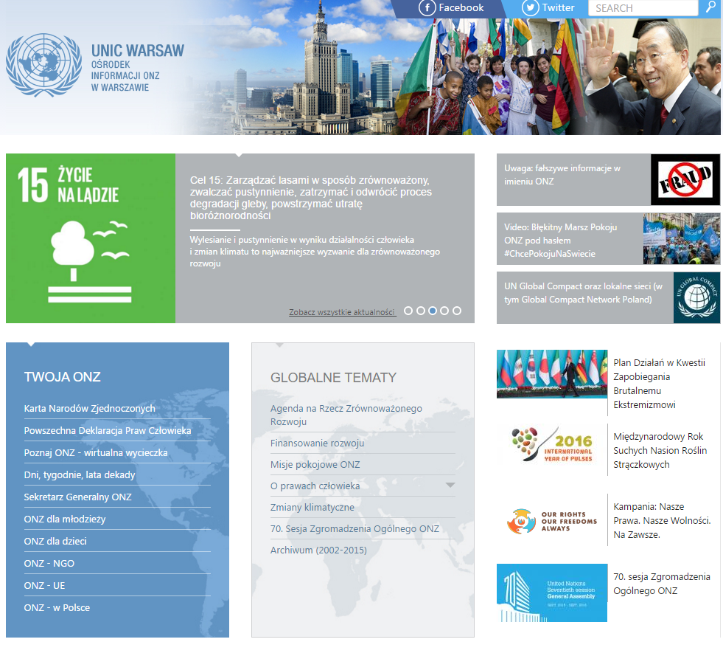
Więcej o Celach
na stronie
Ośrodka Informacji ONZ
www.unic.org.pl
oraz
www.facebook.com/UnicPoland
Twitter.com/UNICWarsaw
Notes:
UN websites on sustainable development in all official languages:
www.un.org/sustainabledevelopment
Link to Publication:
Transforming Our World: The 2030 Agenda for Sustainable Development https://sustainabledevelopment.un.org/content/documents/21252030%20Agenda%20for%20Sustainable%20Development%20web.pdf
Link to 2030 Agenda for Sustainable Development:
Arabic http://www.un.org/ga/search/view_doc.asp?symbol=A/69/L.85&Lang=A
Chinese http://www.un.org/ga/search/view_doc.asp?symbol=A/69/L.85&Lang=C
English http://www.un.org/ga/search/view_doc.asp?symbol=A/69/L.85&Lang=E
French http://www.un.org/ga/search/view_doc.asp?symbol=A/69/L.85&Lang=F
Russian http://www.un.org/ga/search/view_doc.asp?symbol=A/69/L.85&Lang=R
Spanish http://www.un.org/ga/search/view_doc.asp?symbol=A/69/L.85&Lang=S

Slide 22


